Slide 1
What is Data Journalism

Slide 2
Other Names
Data-Driven Journalism
Computer-Assisted Reporting
Data Visualization + Reporting

Slide 3
Equal Parts
Statistics
Economics
Reporting/Research
Data Engineering

Slide 4
Other Subtopics
Forensic Data Analysis
Finance
Accounting

Slide 5


The Opportunity of Finding Stories
With Data
+

Slide 6
Plenty of Stories to Be Found
Ability to Write on Complex Topics
Data/Statistics Knowledge
Deep Understanding of Subject Matter
Non-Partisan, Public Interest Approach

Slide 7

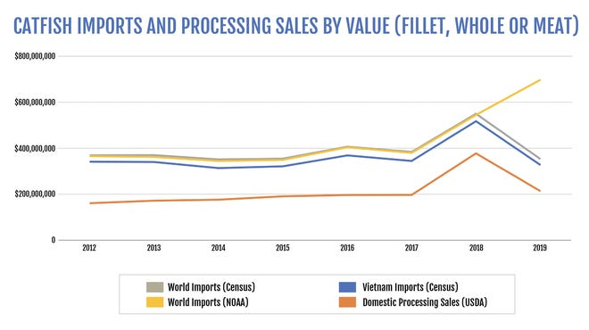
Examples

Slide 8
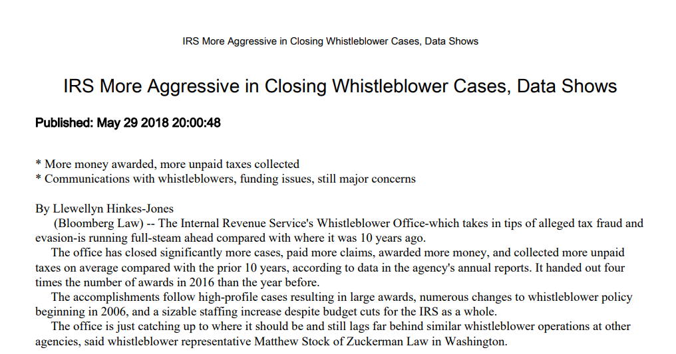
Examples

Slide 9
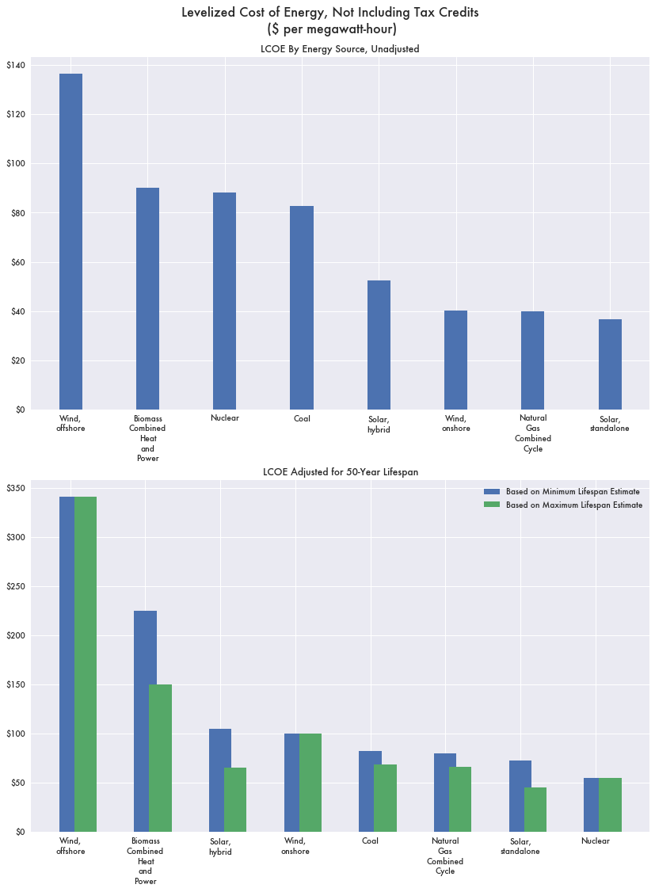
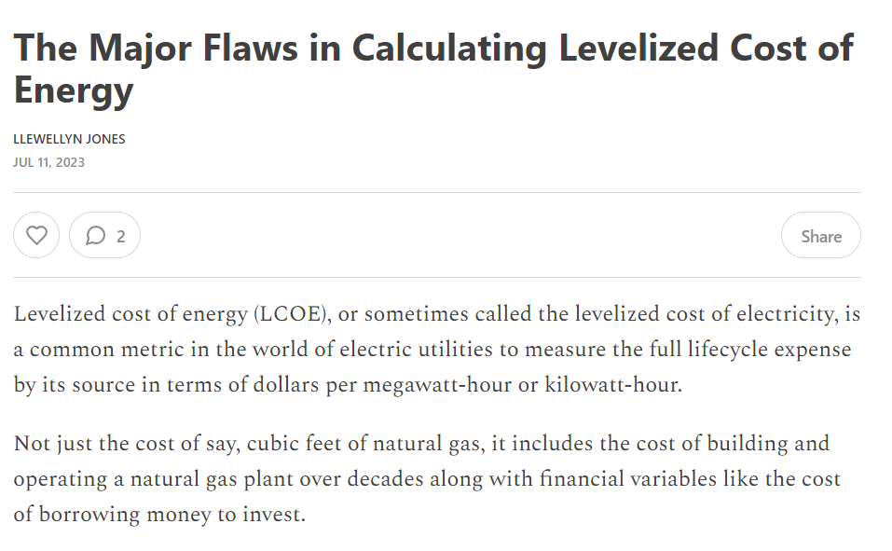
Examples

Slide 10
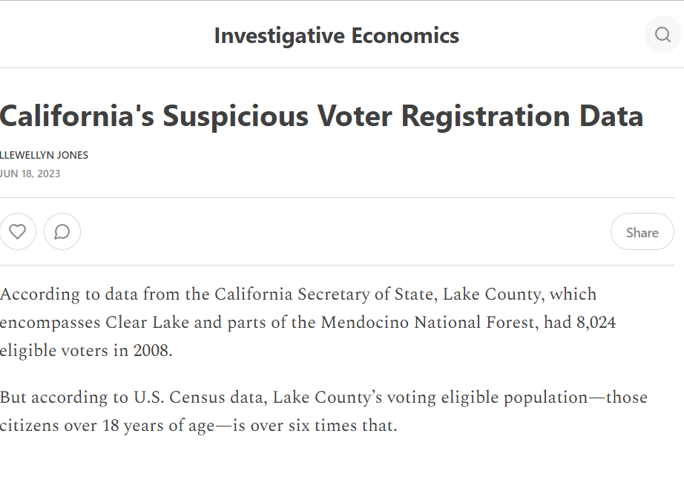
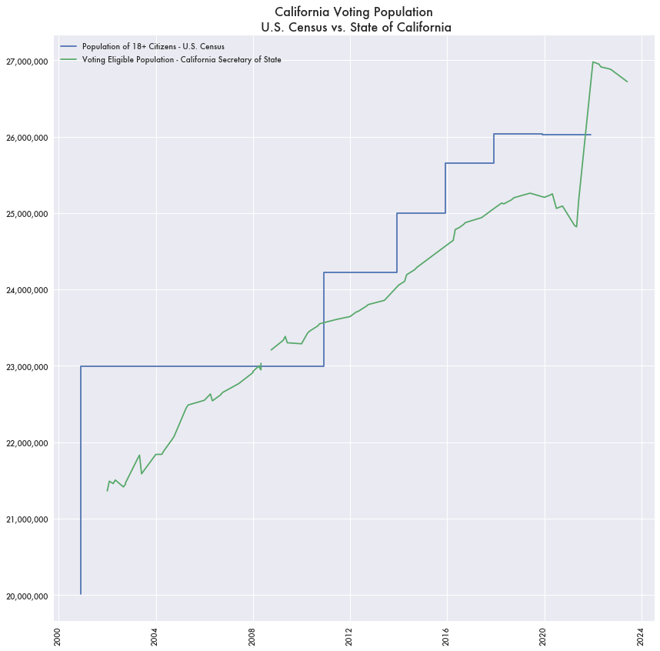
Examples

Slide 11
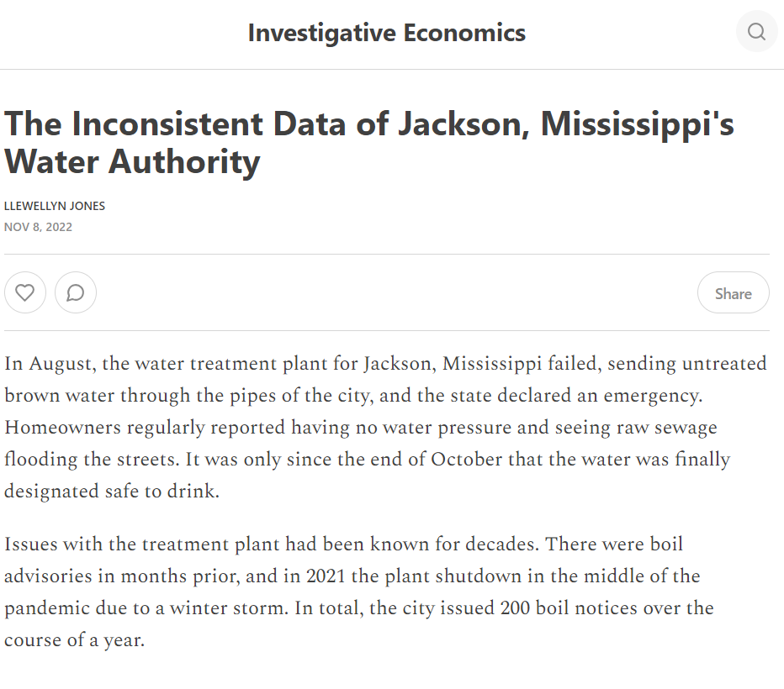
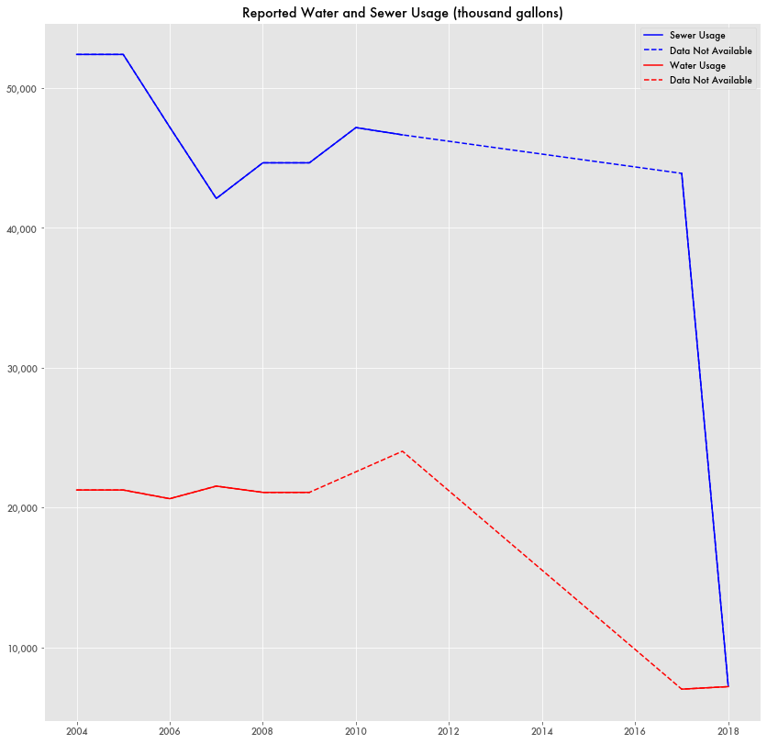
Examples

